Slide 1
Power BI for Enterprise
BA322
Mike Davison
MTC Data Architect - Toronto

Slide 2
Agenda
Governance
Data Sources
Distribution
Consumption
Governance

Slide 3
Governance

Slide 4
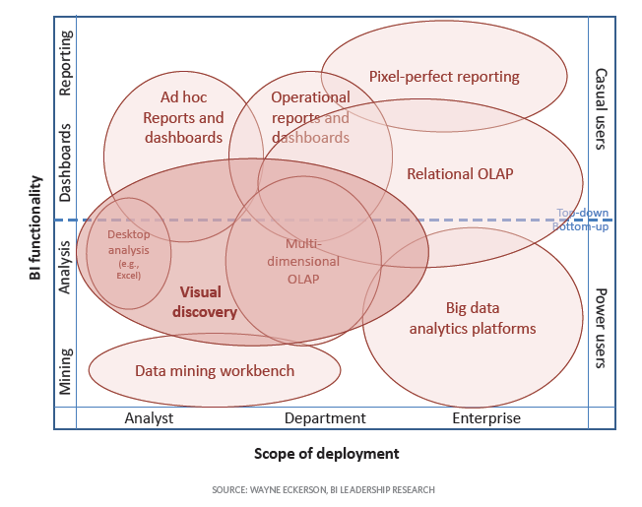
Power BI within Enterprise BI Strategy for Governed Data Discovery
Turning data into information, information into knowledge, knowledge into plans that drives profitable business decisions
Laying out long term foundation for Data Governance
Centralized Control vs. Decentralized Empowerment
Setting a holistic vision for departmental information management
Source: http://www.b-eye-network.com/blogs/eckerson/archives/2013/03/a_guide_for_bi.php
Notes:
To achieve a holistic, long-term vision, people, process, and technology must all be explicitly addressed
Responsibilities should extend up and down the management chain
Without a shared sense of ownership, BI Governance is nearly impossible to implement and maintain
BI Governance is best thought of as a continuous improvement effort

Slide 5
Why Governance is Needed
Plan ahead for self-service BI success
Establish proper change management and training policies
Minimize fear and resistance of new technologies from business users
Proper governance processes
Increase user adoption
Drive infrastructure and technology decisions
Since both business and IT are involved, reduces risks

Slide 6
Implementing Governance
Balance the needs of IT and the business
Every enterprise is unique
Customized governance to environment and culture
Determine initial principles and goals
Clarify ownerships of business information and content
Develop an education strategy and ongoing support plan
Decide what decisions need to be made, and how decisions are made, monitored, and controlled

Slide 7
What to Govern
Successful deployment of a managed self-service BI platform requires the following elements for governance:
Published source data and business data models
PowerBI.com sites or SharePoint farms, include server roles, content database and site collections etc.
Security standards for accessing source data, and business information in reports, Power BI Desktop and Excel

Slide 8
Governance Model
TIGHT CONTROLS
EDW
Push Down Content
Reporting Services
Permanent Record
Subject to Compliance
Business Unit
Dashboards, KPIs &
Scorecards
Push Up Content
Power BI Desktop
Excel or other Reports
Knowledge Management
Information Sharing
Departmental, Team or Group Reporting
Project Reporting
Personal/Private Views
Data Science Exploration
Personal Reporting
LESS CONTROLS

Slide 9
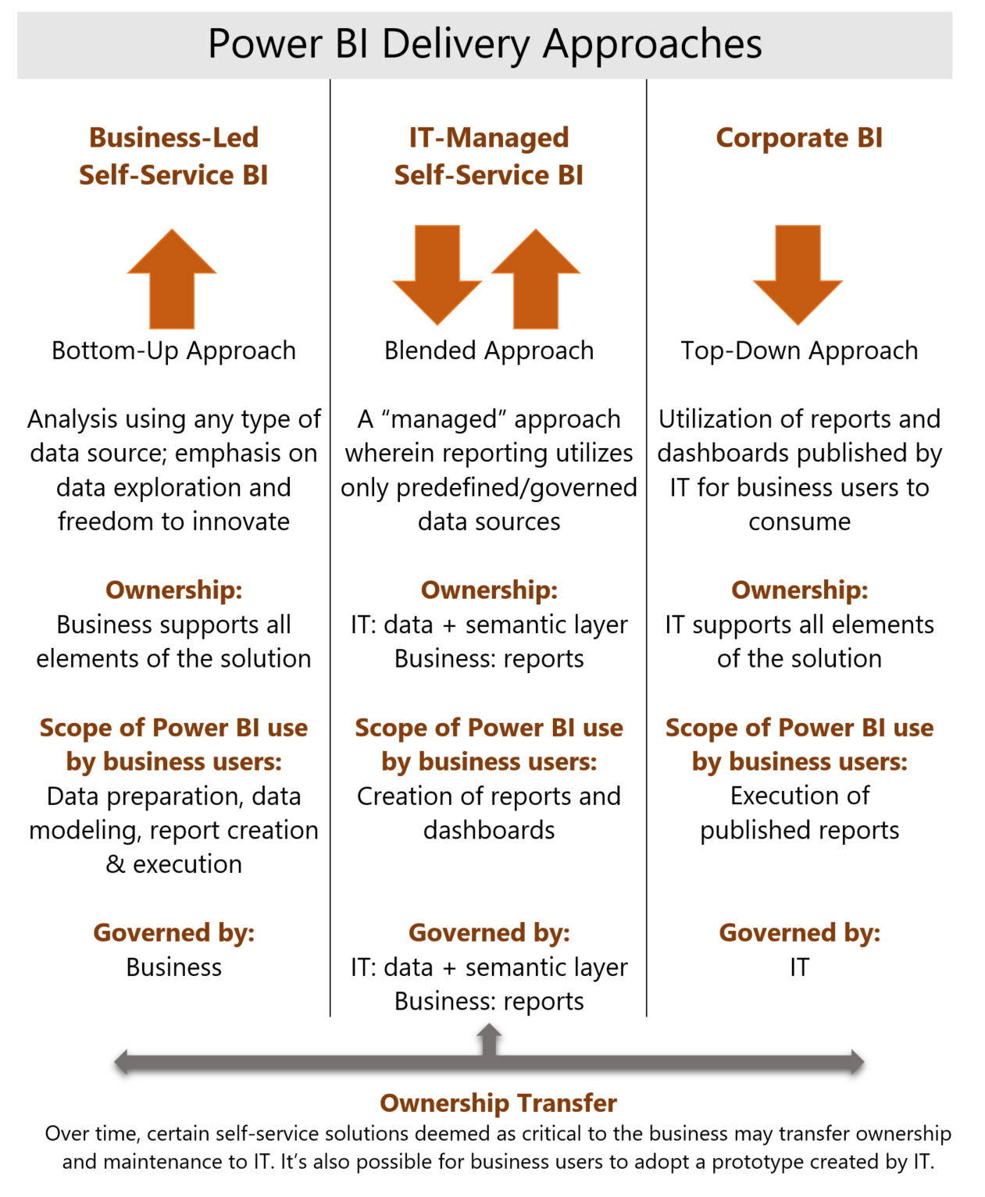
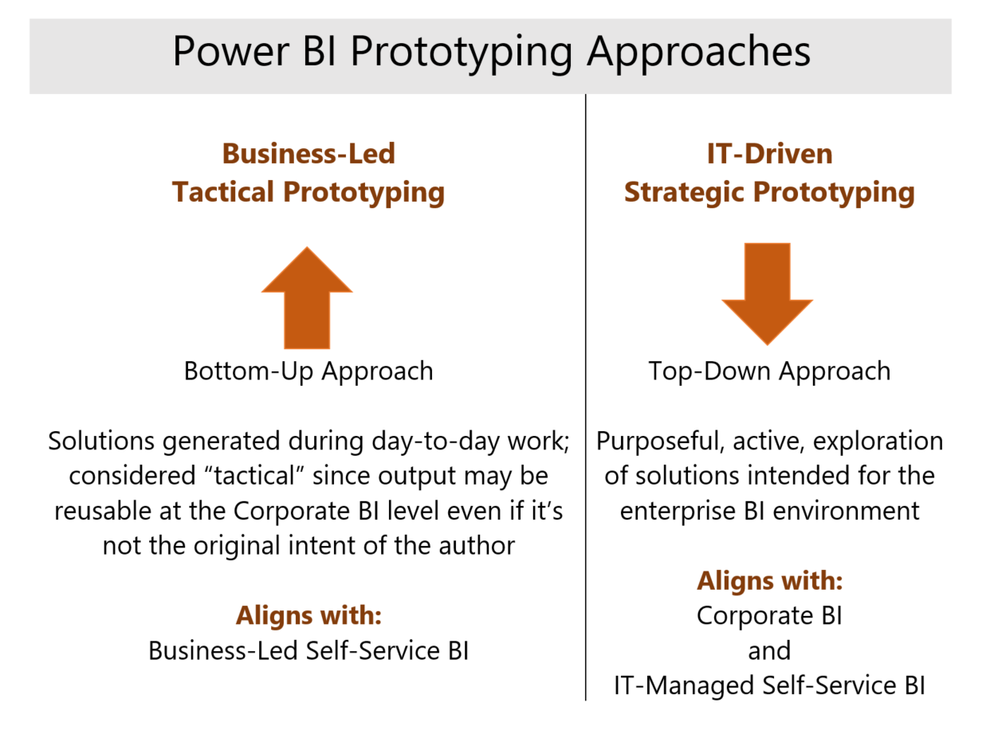
Power BI Governance White Paper

Slide 10
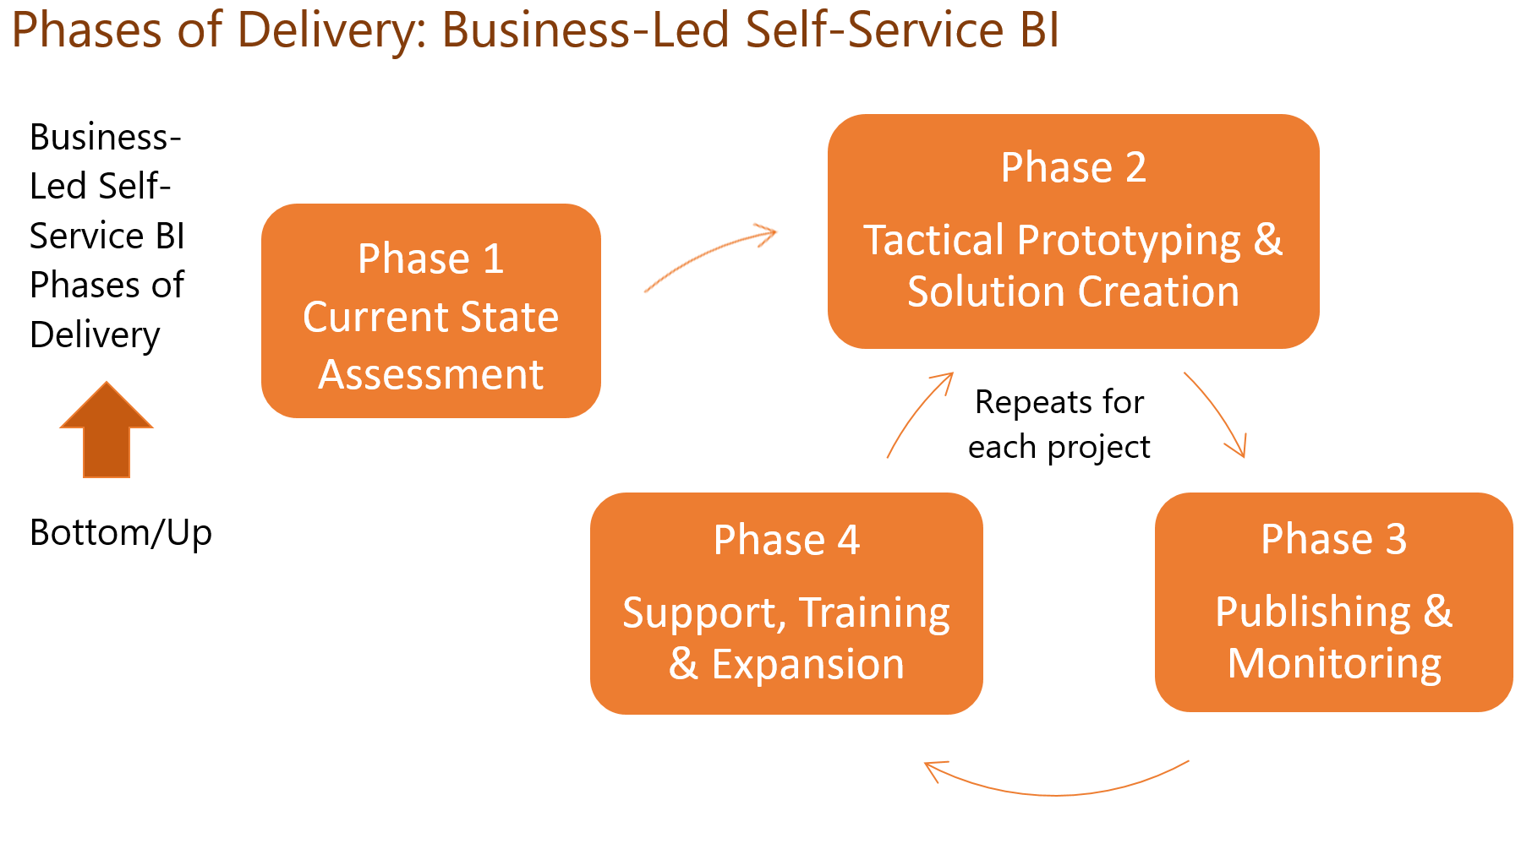

Slide 11


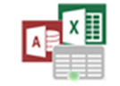
Example
1
Data Sources
6
PowerBI.com
Master Data & Data Quality
1
Add New Reporting Data Source
Organizational Content Packs
Shared Data Sources
Shared Datasets
Shared Data Models
Reports and Dashboards
Groups Workspaces
OneDrive for Business
SharePoint Lists
2
Perform Data Source Security and Governance Management Tasks
2
Data Governance Stewards
Big Data/Data Lake
Security, Roles, Data Sources, Data Catalog, Master Data Version Control and Audit
3
Publish Approved Shared Data Source for Analysts/Power Users
4
Develop Reporting Content with Approved Shared Data Sources
Cloud Apps, Streams & IoT Data
3
Approved Secure Shared Data Sources, Datasets
via Enterprise Data Gateway and/or Content Packs
7
Submit Reporting Content for Approval
based on Governance Guidelines
5
Approval Workflow to Deploy
6
Review, Approve/Disapprove, Add to Catalog for Compliance and Audit
Data Warehouse & App Databases
4
8
5
7
Publish Approved Content with Permissions to Groups
8
View and Explore Power BI Content based on Role/Group Permissions
Power BI Desktop,
Excel, R, Azure ML & other tools
Analysis Services
BI Semantic Models
Analysts/Power Users
Self-Service BI Users

Slide 12
Data Sources

Slide 13
Kinds of Data Sources
Cloud Models
Dataset metadata and data stored in Power BI
Sources:
Imported (Content Packs, Power BI Desktop/Excel Files)
Streaming
External Models
Dataset metadata stored in Power BI; data stored externally
Sources:
Power BI Desktop w/ Live Connection to SSAS (On-Prem or Azure)
Power BI Desktop w/ Direct Query to Source Data (On-Prem or Azure)

Slide 14
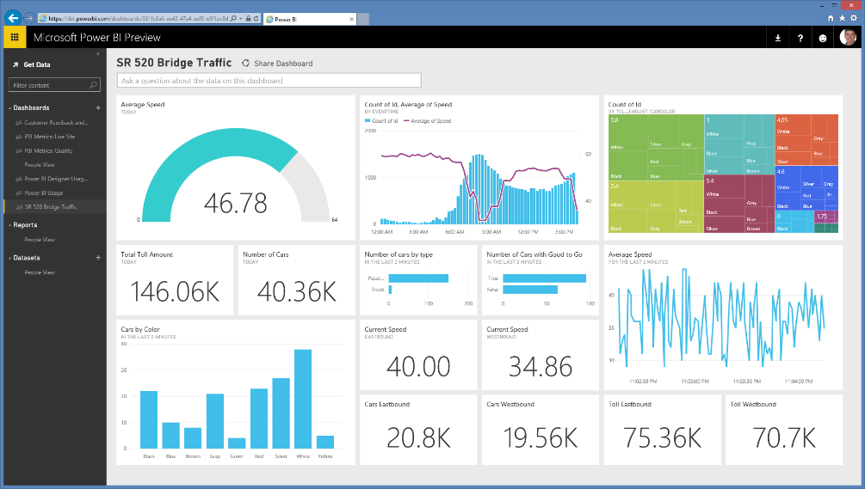
Factors when choosing data source type
Complex
Moderate
Simple
Model size and
complexity
Data update frequency
Active concurrent users
Number of queries
Query latency
time
time
time

Slide 15
Factors when choosing data source type
Import:
Small model size (<1 GB)
Low-to-medium concurrency needs
Infrequent data updates (<8x day)
Live connection to SSAS
Medium-to-large model size (>1 GB)
High concurrency needs
More frequent data updates
DirectQuery
If you have near-real-time or data sovereignty requirements
Be aware of the caveats!

Slide 16
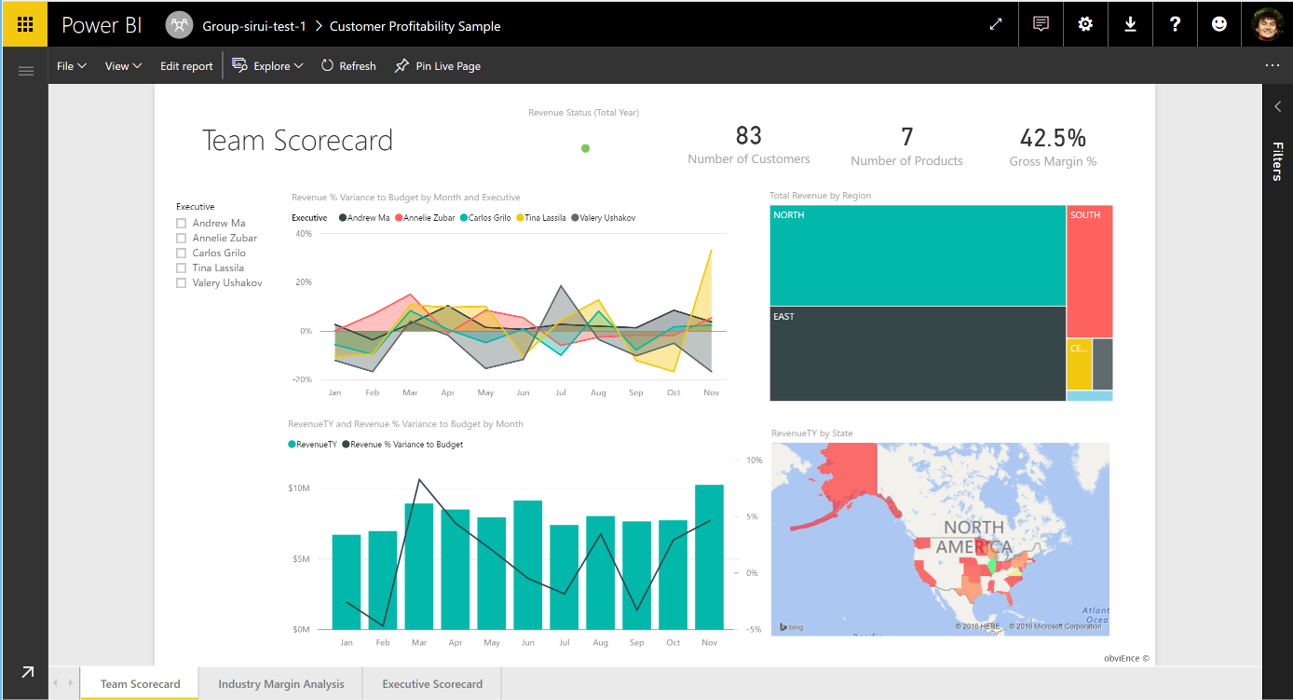
On-premises data gateway
A simplified model
Cloud
Power BI
Personal Gateway
Analysts
Data import only
On-Premises Data Gateway
IT admins
Data import + DirectQuery
Central monitoring and control
On-premises data sources
Gateway
SQL Server
SQL Server Analysis Services
Other data sources
Files, SharePoint

Slide 17
Distribution

Slide 18
Distribution with Power BI
self-service
managed
Sharing
Share single dashboards (and pinned reports)
Low friction
Share to users (new or existing) and SGs
Share single reports in
Organizational Content Packs
Share multiple assets
Allow end user customization
Share to users and SGs
Apps
Share multiple assets
Group related content
Allow end user customization
Share to users and SGs
H1

Slide 19
Collaboration Best Practices
When in doubt, start with a group workspace
Hard to move for now
Copy content being developed in
OneDrive for Business for versioning PBIX
Great recap of the process: https://aka.ms/usingpbiworkspaces
Complete governance/deployment whitepaper: https://aka.ms/pbideploywhitepaper

Slide 20
New Navigation
Feedback from existing navigation
Too much clutter in left navigation for large deployments
Hard to find frequently-accessed content
Preview available now for production customers
Additional enhancements planned in next month
Will become default in CY2017 Q2

Slide 21
Apps
Distribute collections of content
GA in 2017
Apps in left navigation
Theming of apps
Static URLs
Auto-install links
Updates by end of half
Push apps to all users
Controls

Slide 22
Apps and Navigation

Slide 23
Consumption

Slide 24
Consumption Options
Power BI portal (reports, Q&A, Cortana, insights)
Embedded in apps using APIs
Embedded in SharePoint Online
Ad-hoc analysis with Analyze in Excel
Data alerts
Export static views to PowerPoint or print
Email subscriptions
Mobile apps

Slide 25
Email subscriptions
Subscriptions delivered after data refresh
Available on reports (dashboards coming in )
Subscribe yourself (subscribe others coming in )
Workaround today for subscribe others: Outlook rule or Microsoft Flow
Custom visuals not currently supported, coming in
H1
H1
H1
H1
Coming in CY2017 H1

Slide 26
Governance

Slide 27
Data Security
How Power BI secures your data
Encryption of data at rest
How you configure and restrict access
Row-level security
Transport encryption
Policy controls
User authentication
Data authorization
https://aka.ms/pbisecuritywhitepaper

Slide 28
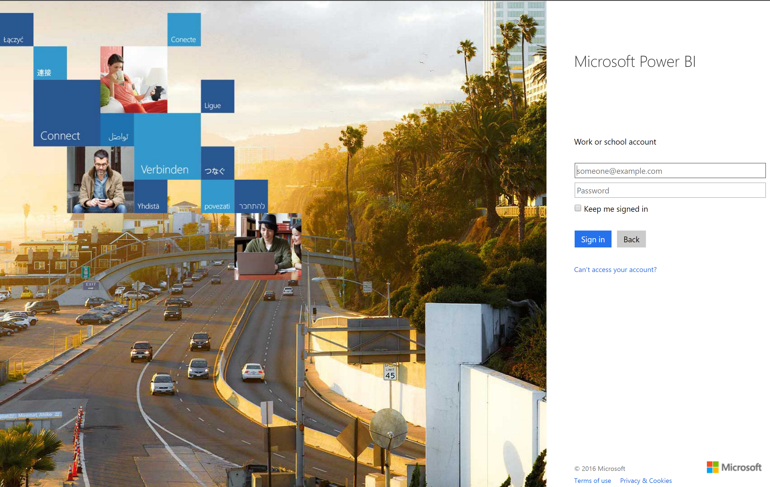
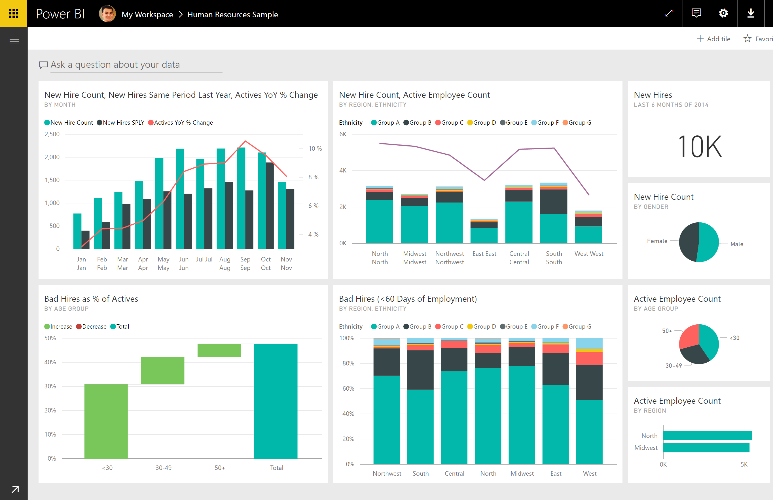
User Authentication
Azure Active Directory (AAD):
Managed and unmanaged directories
Managed and federated auth
Multi-factor auth, conditional access
Single sign-on
Azure Active Directory
Client
Power BI

Slide 29

Data Authorization
1
Reporting authorization
Users have access to dashboards, reports via sharing or organizational content packs
Scoped to user accounts, AAD security groups, or O365 modern groups (content packs only)
Power BI
1
2
Data source authorization
(a) Calls to data sources are made using service-level credentials in the case of cached and Direct Query sources. Authorization in the data source is done using the single service credentials.
(b) for Analysis Services Live Connect, the user’s credentials are used and user authorization is performed in Analysis Services (and RLS can be applied).
(b) will also apply to SAP HANA using Kerberos
3
2b
2a
3
Row-level security (RLS) in Power BI
Row filters can be applied in the Power BI service for cached data.
SQL Server Analysis Services
or SAP HANA
data sources
H1
H1
Coming in CY2017 H1

Slide 30
Policy Controls
I want to…
I should use…
Control who uses Power BI
Office 365 Portal to assign licenses
Audit Power BI activity
Power BI auditing in Office 365 Portal
new
Preview available worldwide
Prevent access off corp. network
AAD Conditional Access
View/control usage PBI features
Power BI Admin Portal
new
Power BI service administrator role available
Control usage of mobile features
Intune MAM

Slide 31
Admin Portal and Auditing

Slide 32
Granular Admin Controls
Today, controls apply at a tenant scope
Soon, controls can be set at a more granular level
ON for entire tenant
OFF for entire tenant
ON for a security group
ON for a security group, except a security group
ON for everyone, except a security group
H1
Coming in CY2017 H1

